Slide 1
Stadium Traffic Emissions:
Making Sports Greener
PARTH DOSHI
ZAIN MUKATY
FELIPE OCHOA
Advisor: Dr. Huemmler
10/1/12

Slide 2
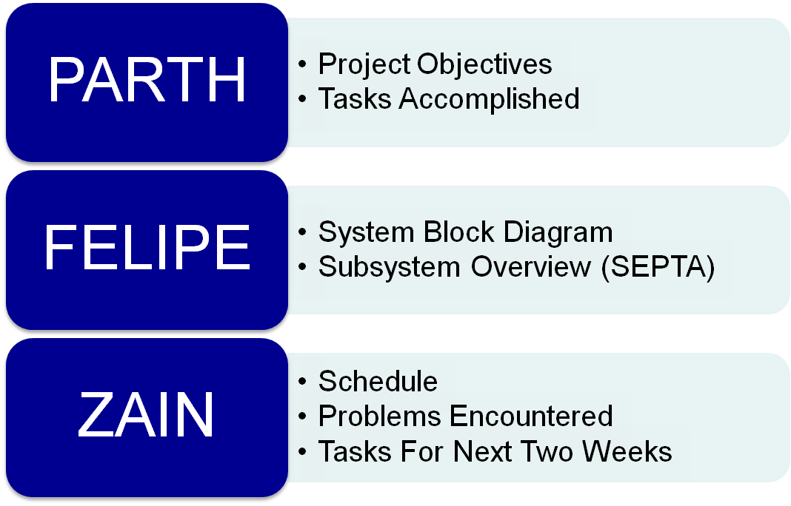
GOALS FOR THIS PRESENTATION
Advisor: Dr. Huemmler
10/1/12

Slide 3
OVERALL PROJECT OBJECTIVE
Design a tool to quantify carbon emissions of fans travelling to and from sports games.
Advisor: Dr. Huemmler
10/1/12

Slide 4
SPECIFIC OBJECTIVES
Develop a comprehensive model of transportation to and from the stadium.
Quantify the total emissions due to transportation to/from games.
Develop a tool to simulate the emissions impact of various initiatives to reduce private transportation usage (e.g. offering a discounted drink to someone who rides the SEPTA).
Create an algorithm to optimally route exiting vehicle traffic according to total emissions generated.
Develop a method for the Philadelphia traffic police to implement the traffic routing recommendations of our project.
Advisor: Dr. Huemmler
10/1/12

Slide 5
TASKS COMPLETED SINCE LAST PRESENTATION
Contacted professionals familiar with planning
  Christopher Puchalsky and Robert Wright
Completed project schedule
Came up with comprehensive system model
Developed list of incentives to smooth traffic
Created database of SEPTA stations and routes
Advisor: Dr. Huemmler
10/1/12

Slide 6
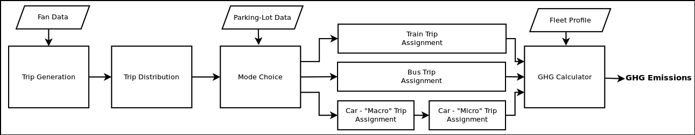
PROJECT OVERVIEW
(SYSTEM BLOCK DIAGRAM)
Part 1
Part 2
Advisor: Dr. Huemmler
10/1/12

Slide 7
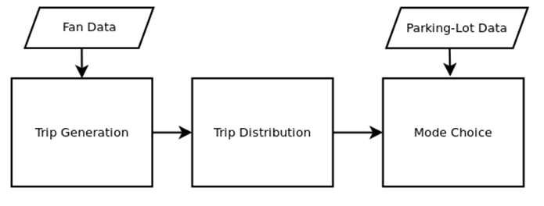
PROJECT OVERVIEW (PART 1)
Advisor: Dr. Huemmler
10/1/12

Slide 8
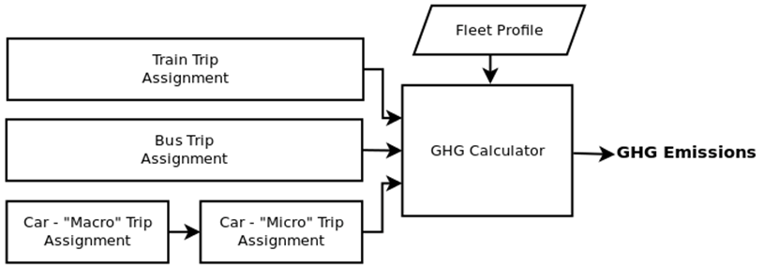
PROJECT OVERVIEW (PART 2)
Advisor: Dr. Huemmler
10/1/12

Slide 9
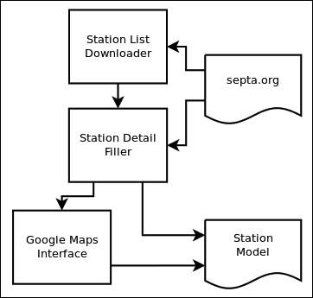
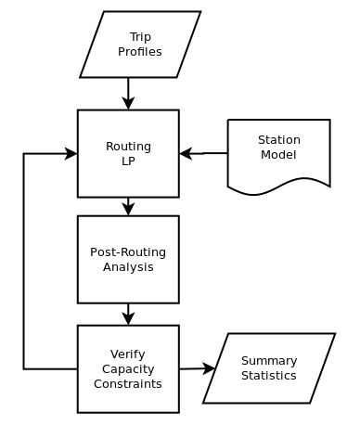
SUBSYSTEMS: SEPTA
STATION SYSTEM
ROUTING SYSTEM
10/1/12
Advisor: Dr. Huemmler

Slide 10
Schedule
Nov | Dec | Jan | Feb | Mar | Apr
Train Model
Car Models
Bus Model
Subsystem Integration
Front End
Advisor: Dr. Huemmler
10/1/12

Slide 11
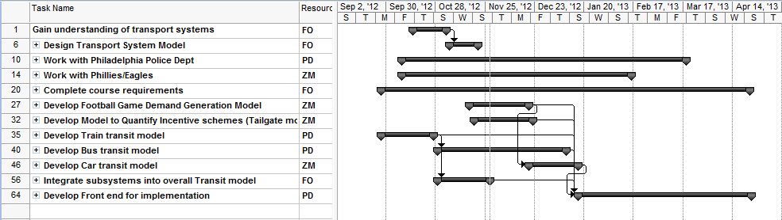
SCHEDULE
Advisor: Dr. Huemmler
10/1/12

Slide 12
PROBLEMS ENCOUNTERED
Slow response from the Eagles
  Mitigant: Pursue other contacts at the Eagles
Difficulty collecting data
  Mitigant: Find alternative data sources or collect primary data by visiting the venue during a game
Advisor: Dr. Huemmler
10/1/12

Slide 13
TASKS FOR NEXT TWO WEEKS
Study GHG Emissions for idling and moving vehicles
Begin working on Car Transit Model
  Emissions Model
Meet with Christopher Puchalsky
Develop Bus Transit Model
Advisor: Dr. Huemmler
10/1/12

Slide 14
QUESTIONS?
10/1/12

